Slide 1




MTA Ridership Patterns
Power BI Specialist Final Project | Digital Egypt Pioneers Initiative (DEPI)
11/29/25
1

Slide 2







Meet Our Project Team
Omar Hamed Ali
Soliman Yehia Mahmoud
Mohamed AlFakharany
Samir Mahmoud Samir
Ahmed Nasr Mesalem
Ahmed Hamdy Abd Elfatah
11/29/25
2

Slide 3
Agenda
01
02
03
Problem and Objectives
Data and Methodology
Rider Trends and Recovery
Understand the context and define key goals
Data sources and analysis methods
Analysis of usage patterns and recovery
04
05
06
Weekday and Holiday Patterns
Insights and Recommendations
Deliverables
Study daily behaviors
Data-driven conclusions
Final project outcomes
07
Conclusion and Future Work
Next steps and opportunities
11/29/25
3

Slide 4
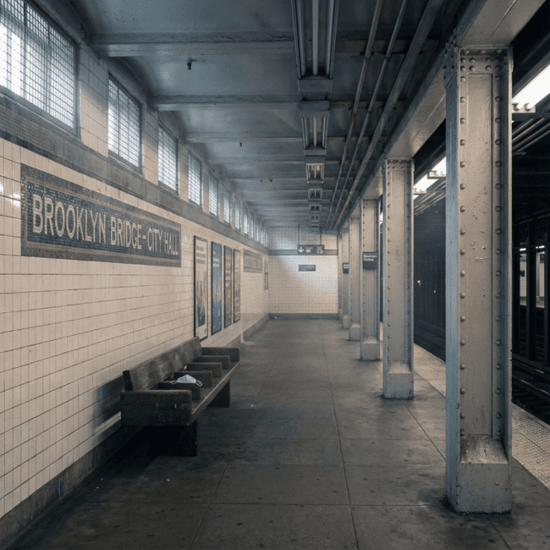
Problem Context: COVID-19 and Public Transport
The COVID-19 pandemic disrupted public transport systems worldwide, with a significant impact on MTA in New York.
Sharp decrease in ridership due to lockdowns and remote work
Financial pressures and uncertainty for transport agencies
Need to understand new travel behaviors instead of assuming a full return to old patterns
11/29/25
4

Slide 5





Project Goals
Main Goal
Time Comparison
Measure Recovery
Analyze MTA rider patterns before and after COVID-19 using Power BI, and understand the "new normal"
Compare daily rider levels pre-COVID (2019) with post-COVID
Measure rider recovery by transport type (subway, buses, bridges and tunnels)
Daily Patterns
Recommendations
Identify weekday vs. weekend patterns, including the Friday effect
Provide data-driven recommendations for fares, services, and marketing
11/29/25
5

Slide 6
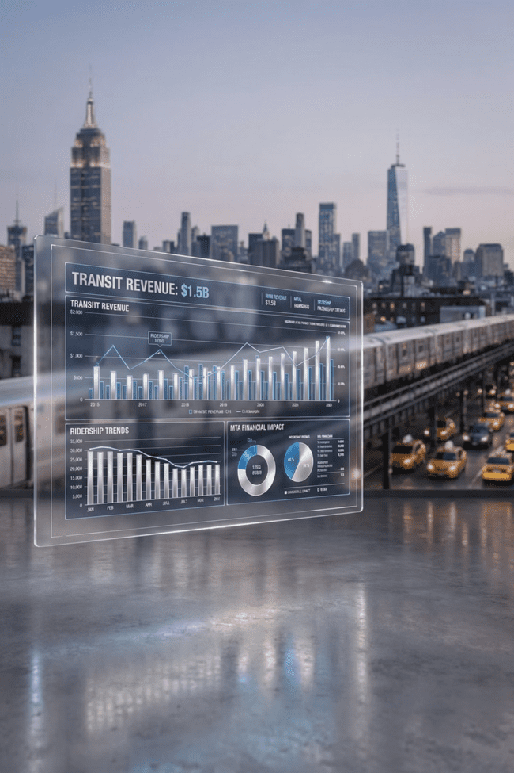

Business Impact and Motivation
7.90M
4.65M
41%
Average Daily Ridership Pre-COVID
Average Daily Ridership Post-COVID
Ridership Loss
Significant Decrease in Usage
2019 Baseline Level
Current Transit Situation
Estimated Financial Impact: $21.81 Billion
These changes directly affect MTA's ability to fund operations, maintenance, and future investments.
11/29/25
6

Slide 7
Data Structure and Key Fields
Key Columns
Field
Description
Included Transportation Modes
Date
Daily Date
Subways
Buses
Mode / System
Mode of Transport
LIRR
Daily Ridership
Daily Ridership
Metro-North
Bridges & Tunnels
2019 Baseline
2019 Baseline
Access-A-Ride
Recovery %
Recovery %
The data is a daily time series, allowing for detailed trend analysis.
11/29/25
7

Slide 8
Data Cleaning and Preparation
Import
Standardize
Import raw CSV files into Power BI
Standardize column names and data types (dates, numbers, categories)
Process
Filter
Process missing or inconsistent values
Filter out invalid or out-of-scope records
"From raw CSV to an analysis-ready model"
This ensures reliable performance indicators and accurate visualizations for comprehensive analysis.
11/29/25
8

Slide 9

Modeling and Calculations (DAX)
Key DAX Metrics
Total Ridership
Total number of passengers
Average Daily Ridership
Average daily passengers
Recovery % vs 2019
Recovery percentage compared to 2019
Ridership Difference
Absolute and relative difference in passengers
11/29/25
9

Slide 10
Overall Ridership Trends
Key Messages
"Ridership has not fully recovered to 2019 levels, suggesting a structural change rather than a temporary shock."
Significant drop from 7.90 million to 4.65 million daily riders
Recovery is partial and uneven over time
Ridership has not fully returned to 2019 levels
11/29/25
10

Slide 11
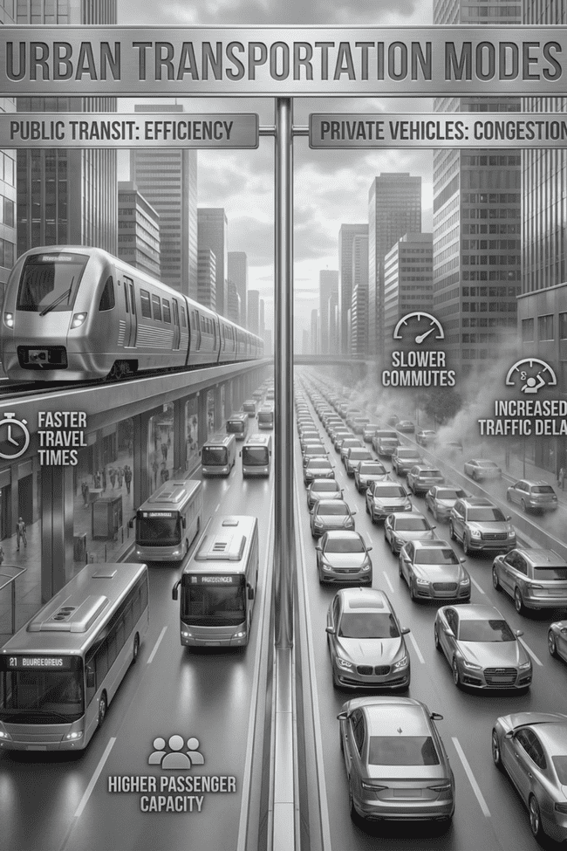


Mode Recovery: The Big Picture
54.17%
93.36%
Subway
Bridges & Tunnels
Moderate recovery for public transit
Near-complete recovery for cars
Key Insight
Public transport (subway, buses) is slow to recover, while car-related infrastructure shows near-complete recovery.
11/29/25
11

Slide 12
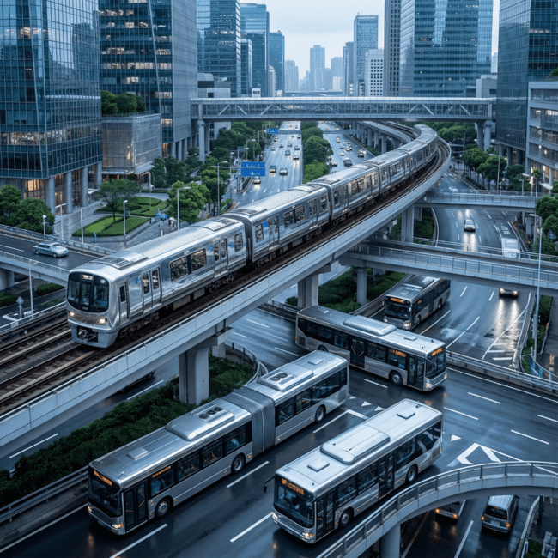
Recovery of Modes: Focus on Public Transit
Detailed Comparison
54%
Subways
Subways
48%
Buses
Buses
62%
LIRR
What Does This Mean?
Long Island Rail Road
Which public transit mode is recovering faster?
Which was most affected by the pandemic?
58%
Impact on service planning and operations
Metro-North
Metro-North
11/29/25
12

Slide 13
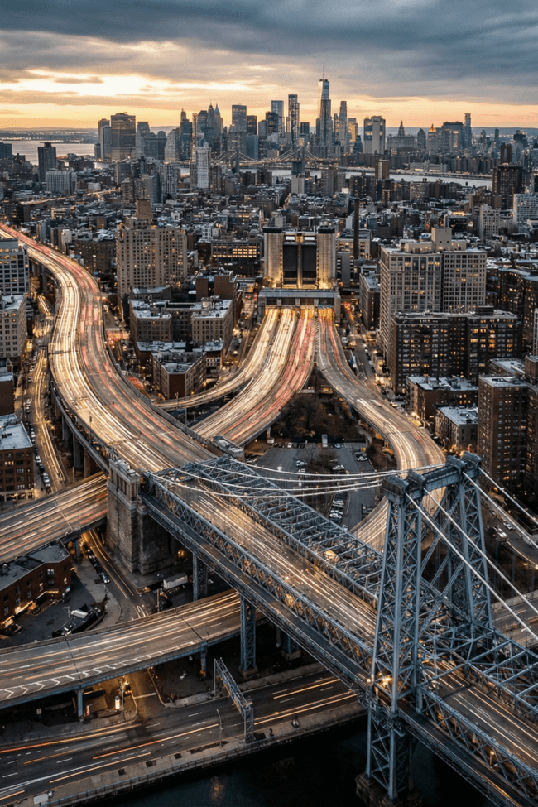
Modal Recovery: Bridges and Tunnels / Car Behavior
93.36%
Bridges and Tunnels Recovery
Strong Shift Towards Cars
Possible Reasons
High recovery (~93%+) indicates a strong preference for car use after COVID.
Perceived safety, comfort, flexibility in personal travel.
Impacts
Traffic congestion, environmental impact, need for incentives to return to public transport.
11/29/25
13

Slide 14

Weekday Patterns Overview
1
Monday
Lower than expected
2
Tuesday - Thursday
Highest - Peak of the week
3
Friday
Significant drop
"Traditional 5-day commute shifted to a 3-day in-office core (Tuesday-Thursday)."
4
Weekend
Different patterns
11/29/25
14

Slide 15
In-Depth Analysis of the "Friday Effect"
What is the Friday Effect?
Many workers choose to work remotely or have flexible schedules on Fridays, leading to:
Reduced demand at the end of the work week
A shift in traditional commuting patterns
The "Friday Effect": Ridership consistently peaks Tuesday to Thursday, then falls dramatically on Friday. This visible, repeatable pattern proves hybrid work is a permanent fixture.
11/29/25
15

Slide 16
Weekend Behavior and Recovery
66.73%
55.25%
Sunday
Monday
Highest recovery of the week
Lowest recovery of the week
Explanation
Opportunities
Stronger relative recovery on weekends suggests more leisure and non-work trips.
Potential for weekend-focused products (e.g., day tickets, family offers).
11/29/25
16

Slide 17
Summary of Key Insights
Ridership Significantly Lower than 2019
Public Transport Recovery is Slower
Ridership remains much lower than 2019 levels, with major revenue impacts.
The recovery of public transport (metro, buses) is much slower than car-related travel.
Hybrid Work Created a New Pattern
Weekends are Stronger
Hybrid work created a noticeable Tuesday-Thursday core and a Friday effect.
Weekends, especially Sundays, show relatively higher recovery, linked to leisure and non-commute trips.
11/29/25
17

Slide 18



Recommendations
Pricing & Products
Offer flexible tickets for 3-day commute weeks
Introduce weekend passes / family bundles to capture leisure demand
Service & Operations
Align frequency with peak days (Tuesday-Thursday)
Reduce excess capacity on low-demand days where appropriate
Consider targeted improvements where recovery is stronger
Marketing & Communication
Promote public transit as safe, reliable, and convenient for both work and leisure
Run special campaigns around weekends and Fridays
Highlight environmental and economic benefits
11/29/25
18

Slide 19
Thank You
Deliverables
Comprehensive interactive Power BI report
In-depth data analysis of passenger patterns
Actionable insights and strategic recommendations
Dynamic visualizations and dashboards
11/29/25
19

